Slide 1
Transaction Processing

Slide 2
Problems in Transaction Processing
Lost update problem
Unrepeatable Read Problem
Dirty read problem
Phantom Read Problem

Slide 3
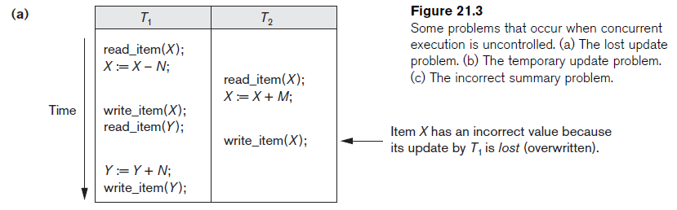
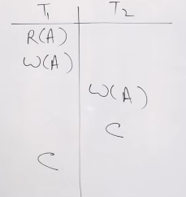
Lost update problem / Write-Write conflict Problem
Occurs when two transactions update the same data item, but both read the same original value before update.

Slide 4
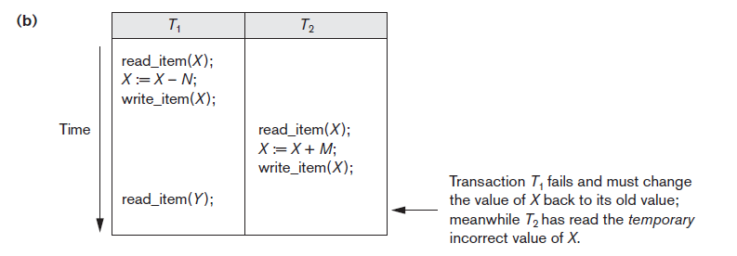
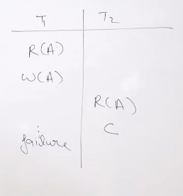

The Temporary Update (or Dirty Read) Problem.
This occurs when one transaction T1 updates a database item X, which is accessed (read) by another transaction T2; then T1 fails for some reason; X was (read) by T2 before its value is changed back (rolled back or UNDONE) after T1 fails.

Slide 5
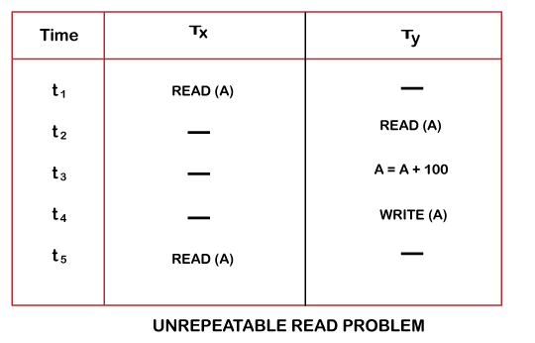
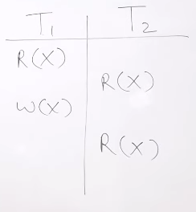
Unrepeatable Read Problem
A transaction T1 may read an item (say, available seats on a flight); later, T1 may read the same item again and get a different value because another transaction T2 has updated the item (reserved seats on the flight) between the two reads by T1.

Slide 6
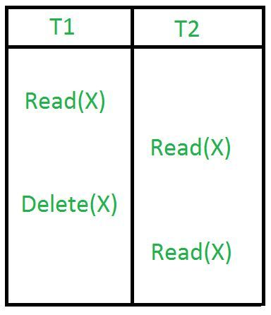
Phantom Read Problem
The phantom read problem occurs when a transaction reads a variable once but when it tries to read that same variable again, an error occurs saying that the variable does not exist.

Slide 7
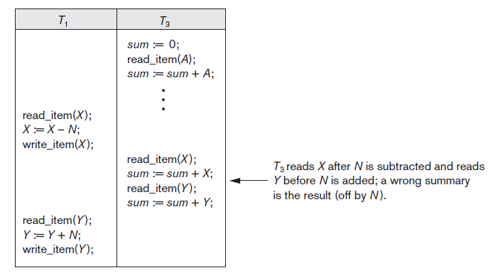
The Incorrect Summary Problem
One transaction is calculating an aggregate summary function on a number of records (for example, sum (total) of all bank account balances) while other transactions are updating some of these records (for example, transferring a large amount between two accounts, the aggregate function may read some values before they are updated and others after they are updated.

Slide 8
Schedules and Conflicts
In a system with a number of simultaneous transactions, a schedule is the total order of execution of operations. Given a schedule S comprising of n transactions, say T1, T2, T3………..Tn; for any transaction Ti, the operations in Ti must execute as laid down in the schedule S.
Transaction schedule (or history): When transactions are executing concurrently in an interleaved fashion, the order of execution of operations from the various transactions forms what is known as a transaction schedule (or history).
Types of Schedules
Serial Schedules
Parallel Schedules

Slide 9
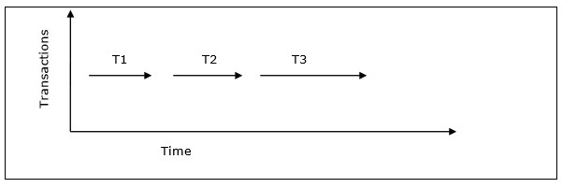
Schedules and Conflicts
Types of Schedules
Serial Schedules
In a serial schedule, at any point of time, only one transaction is active, i.e. there is no overlapping of transactions.

Slide 10
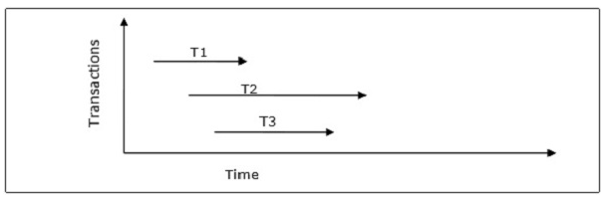
Schedules and Conflicts
Types of Schedules
Parallel Schedules
In parallel schedules, more than one transactions are active simultaneously, i.e. the transactions contain operations that overlap at time.

Slide 11
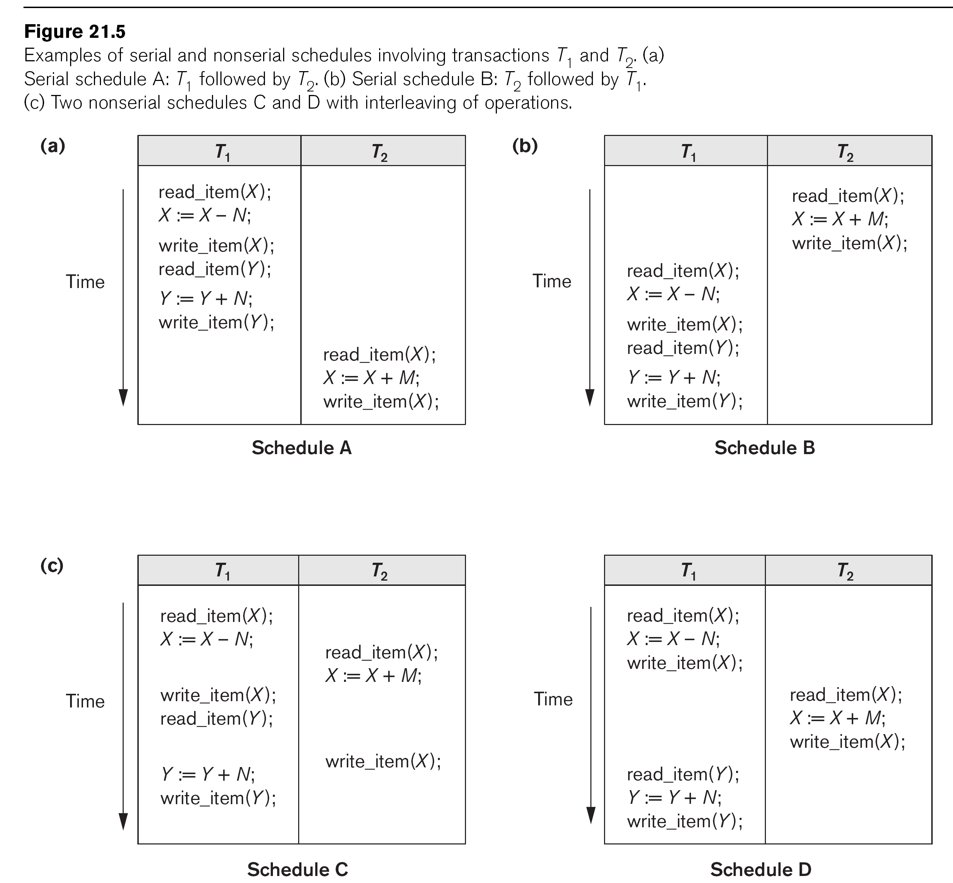

Slide 12
Schedules of Transactions (cont.)
Schedules can also be displayed in more compact notation
Order of operations from left to right
Include only read (r) and write (w) operations, with transaction id (1, 2, …) and item name (X, Y, …)
Can also include other operations such as b (begin), e (end), c (commit), a (abort)
Schedules in Figure 21.5 would be displayed as follows:
Schedule A: r1(X); w1(X); r1(Y); w1(Y); r2(X); w2(x);
Schedule B: r2(X); w2(X); r1(X); w1(X); r1(Y); w1(Y);
Schedule C: r1(X); r2(X); w1(X); r1(Y); w2(X); w1(Y);
Schedule D: r1(X); w1(X); r2(X); w2(X); r1(Y); w1(Y);

Slide 13
Schedules of Transactions (cont.)
Formal definition of a schedule (or history) S of n transactions T1, T2, ..., Tn :
An ordering of all the operations of the transactions subject to the constraint that, for each transaction Ti that participates in S, the operations of Ti in S must appear in the same order in which they occur in Ti.
Note: Operations from other transactions Tj can be interleaved with the operations of Ti in S.

Slide 14
Schedules of Transactions (cont.)
Generally very large number of possible schedules
Some schedules are easy to recover from after a failure, while others are not.
Some schedules produce correct results, while others produce incorrect results
Schedules are classifying based on ease of recovery (recoverability) and correctness (serializability)

Slide 15
Characterizing Schedules based on Recoverability
Schedules classified into two main classes:
Recoverable schedule: One where no committed transaction needs to be rolled back (aborted).
A schedule S is recoverable if no transaction T in S commits until all transactions T’ that have written an item that T reads have committed.
Non-recoverable schedule: A schedule where a committed transaction may have to be rolled back during recovery.
This violates Durability from ACID properties (a committed transaction cannot be rolled back) and so non-recoverable schedules should not be allowed.

Slide 16
Characterizing Schedules Based on Recoverability (cont.)
Example:
Schedule A: r1(X); w1(X); r2(X); w2(X); c2; r1(Y); w1(Y); c1 (or a1)
Schedule B: r1(X); w1(X); r2(X); w2(X); r1(Y); w1(Y); c1 (or a1), c2;
Schedule A is non-recoverable because T2 reads the value of X that was written by T1, but then T2 commits before T1 commits or aborts
To make it recoverable, the commit of T2 (c2) must be delayed until T1 either commits, or aborts (Schedule B)
If T1 commits, T2 can commit
If T1 aborts, T2 must also abort because it read a value that was written by T1; this value must be undone (reset to its old value) when T1 is aborted known as cascading rollback

Slide 17
Characterizing Schedules based on Recoverability (cont.)
Recoverable schedules can be further refined:
Cascadeless schedule: A schedule in which a transaction T2 cannot read an item X until the transaction T1 that last wrote X has committed.
The set of cascadeless schedules is a subset of the set of recoverable schedules.
Schedules requiring cascaded rollback: A schedule in which an uncommitted transaction T2 that read an item that was written by a failed transaction T1 must be rolled back.

Slide 18
Characterizing Schedules Based on Recoverability (cont.)
Example:
Schedule B: r1(X); w1(X); r2(X); w2(X); r1(Y); w1(Y); c1 (or a1);
Schedule C: r1(X); w1(X); r1(Y); w1(Y); c1; r2(X); w2(X); ...
Schedule B is not cascadeless because T2 reads the value of X that was written by T1 before T1 commits
If T1 aborts (fails), T2 must also be aborted (rolled back) resulting in cascading rollback
To make it cascadeless, the r2(X) of T2 must be delayed until T1 commits (or aborts and rolls back the value of X to its previous value) – see Schedule C

Slide 19
Characterizing Schedules based on Recoverability (cont.)
Cascadeless schedules can be further refined:
Strict schedule: A schedule in which a transaction T2 can neither read nor write an item X until the transaction T1 that last wrote X has committed.
The set of strict schedules is a subset of the set of cascadeless schedules.
If blind writes are not allowed, all cascadeless schedules are also strict
Blind write: A write operation w2(X) that is not preceded by a read r2(X).

Slide 20
Characterizing Schedules Based on Recoverability (cont.)
Example:
Schedule C: r1(X); w1(X); r1(Y); w1(Y); c1; r2(X); w2(X); …
Schedule D: r1(X); w1(X); w3(X); r1(Y); w1(Y); c1; r2(X); w2(X); …
Schedule E: r1(X); w1(X); r1(Y); w1(Y); c1; w3(X); r2(X); w2(X); …
Schedule C is cascadeless and also strict (because it has no blind writes)
Schedule D is cascadeless, but not strict (because of the blind write w3(X), which writes the value of X before T1 commits)
To make it strict, w3(X) must be delayed until after T1 commits – see Schedule E

Slide 21
Characterizing Schedules Based on Recoverability (cont.)
Summary:
Many schedules can exist for a set of transactions
The set of all possible schedules can be partitioned into two subsets: recoverable and non-recoverable
A subset of the recoverable schedules are cascadeless
If blind writes are allowed, a subset of the cascadeless schedules are strict
If blind writes are not allowed, the set of cascadeless schedules is the same as the set of strict schedules

Slide 22
Characterizing Schedules based on Serializability
Among the large set of possible schedules, we want to characterize which schedules are guaranteed to give a correct result
The consistency preservation property of the ACID properties states that: each transaction if executed on its own (from start to finish) will transform a consistent state of the database into another consistent state.
Hence, each transaction is correct on its own

Slide 23
Characterizing Schedules based on Serializability (cont.)
Serial schedule: A schedule S is serial if, for every transaction T participating in the schedule, all the operations of T are executed consecutively (without interleaving of operations from other transactions) in the schedule. Otherwise, the schedule is called non-serial.
Based on the consistency preservation property, any serial schedule will produce a correct result (assuming no inter-dependencies among different transactions)
Serial schedules are not feasible for performance reasons:
No interleaving of operations
Long transactions force other transactions to wait
System cannot switch to other transaction when a transaction is waiting for disk I/O or any other event
Need to allow concurrency with interleaving without sacrificing correctness

Slide 24
Characterizing Schedules based on Serializability (cont.)
Serializable schedule: A schedule S is serializable if it is equivalent to some serial schedule of the same n transactions.
Question: How do we define equivalence of schedules?

Slide 25
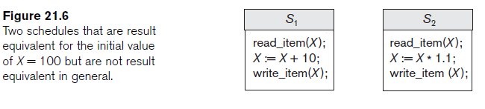
Equivalence of Schedules
Result equivalent: Two schedules are called result equivalent if they produce the same final state of the database.
Difficult to determine without analyzing the internal operations of the transactions, which is not feasible in general.
May also get result equivalence by chance for a particular input parameter even though schedules are not equivalent in general.

Slide 26
Equivalence of Schedules (cont.)
Conflict equivalent: Two schedules are conflict equivalent if the relative order of any two conflicting operations is the same in both schedules.
Commonly used definition of schedule equivalence
Two operations are conflicting if:
They access the same data item X
They are from two different transactions
At least one is a write operation
Read-Write conflict example: r1(X) and w2(X)
Write-write conflict example: w1(Y) and w2(Y)

Slide 27
Equivalence of Schedules (cont.)
Changing the order of conflicting operations generally causes a different outcome.
Example: changing r1(X); w2(X) to w2(X); r1(X) means that T1 will read a different value for X
Example: changing w1(Y); w2(Y) to w2(Y); w1(Y) means that the final value for Y in the database can be different.
Note that read operations are not conflicting; changing r1(Z); r2(Z) to r2(Z); r1(Z) does not change the outcome.

Slide 28
Characterizing Scedules Based on Serializability (cont.)
Conflict equivalence of schedules is used to determine which schedules are correct in general (serializable)
A schedule S is said to be serializable if it is conflict equivalent to some serial schedule S’.
A serializable schedule is considered to be correct because it is equivalent to a serial schedule, and any serial schedule is considered to be correct
It will leave the database in a consistent state.
The interleaving is appropriate and will result in a state as if the transactions were serially executed, yet will achieve efficiency due to concurrent execution and interleaving of operations from different transactions

Slide 29
Characterizing Schedules based on Serializability (cont.)
Serializability is generally hard to check at run-time:
Interleaving of operations is generally handled by the operating system through the process scheduler.
Difficult to determine beforehand how the operations in a schedule will be interleaved.
Transactions are continuously started and terminated
DBMS concurrency control subsystem will enforce the protocol rules and thus guarantee serializability of schedules
Current approach used in most DBMSs:
Use of locks with two phase locking

Slide 30
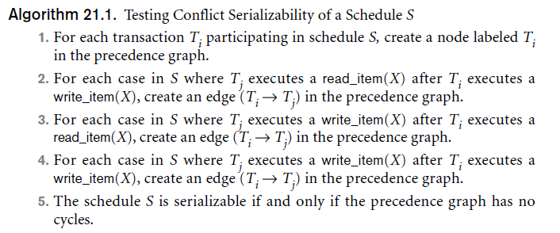
Testing for conflict serializability
Looks at only r(X) and w(X) operations in a schedule.
Constructs a precedence graph (serialization graph) – one node for each transaction, plus directed edges
An edge is created from T_{i} to T_{j} if one of the operations in T_{i} appears before a conflicting operation in T_{j}
The schedule is serializable if and only if the precedence graph has no cycles.

Slide 31
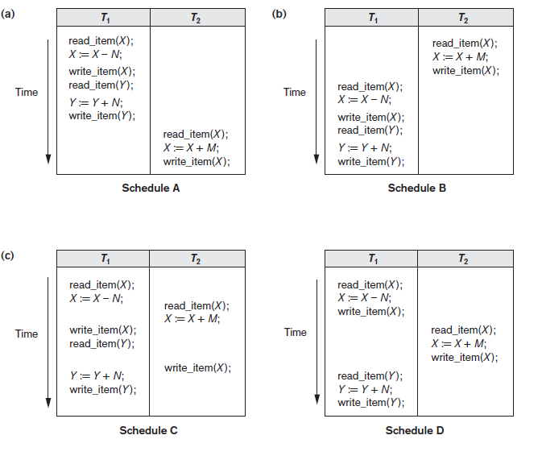

Slide 32
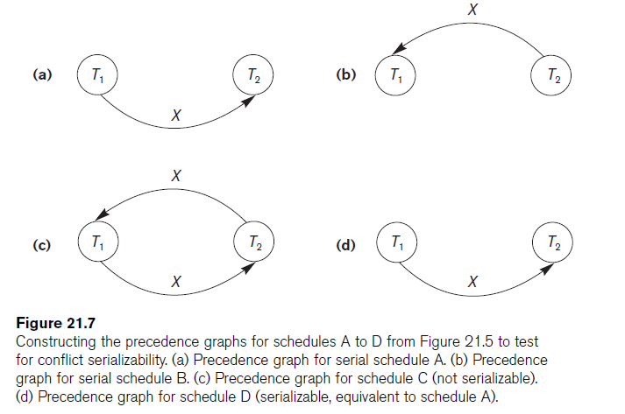

Slide 33
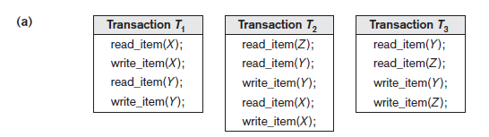
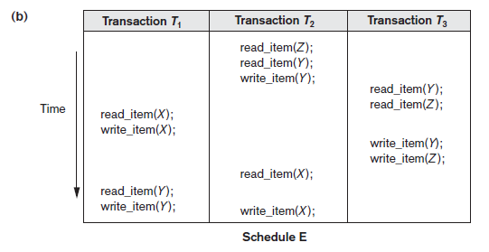
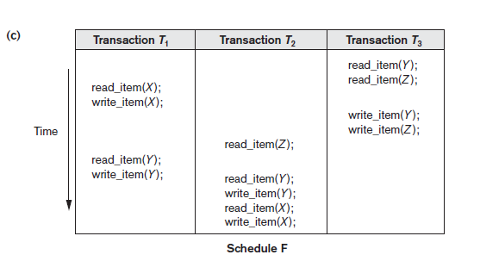

Slide 34
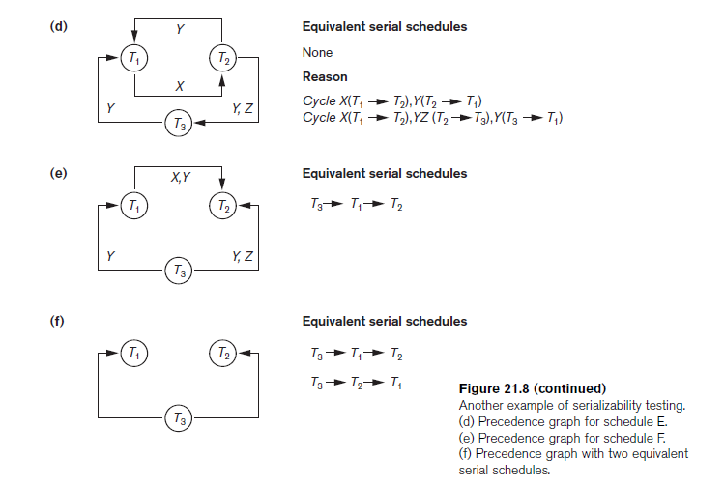

Slide 35
Characterizing Schedules based on Serializability (cont.)
View equivalence: A less restrictive definition of equivalence of schedules than conflict serializability when blind writes are allowed
View serializability: definition of serializability based on view equivalence. A schedule is view serializable if it is view equivalent to a serial schedule.

Slide 36
Characterizing Schedules based on Serializability (cont.)
Two schedules are said to be view equivalent if the following three conditions hold:
The same set of transactions participates in S and S’, and S and S’ include the same operations of those transactions.
For any operation Ri(X) of Ti in S, if the value of X read was written by an operation Wj(X) of Tj (or if it is the original value of X before the schedule started), the same condition must hold for the value of X read by operation Ri(X) of Ti in S’.
If the operation Wk(Y) of Tk is the last operation to write item Y in S, then Wk(Y) of Tk must also be the last operation to write item Y in S’.

Slide 37
Characterizing Schedules based on Serializability (cont.)
The premise behind view equivalence:
Each read operation of a transaction reads the result of the same write operation in both schedules.
“The view”: the read operations are said to see the same view in both schedules.
The final write operation on each item is the same on both schedules resulting in the same final database state in case of blind writes.

Slide 38
Characterizing Schedules based on Serializability (cont.)
Relationship between view and conflict equivalence:
The two are same under constrained write assumption (no blind writes allowed)
Conflict serializability is stricter than view serializability when blind writes occur (a schedule that is view serializable is not necessarily conflict serialiable.
Any conflict serializable schedule is also view serializable, but not vice versa.

Slide 39
Characterizing Schedules based on Serializability (cont.)
Relationship between view and conflict equivalence (cont):
Consider the following schedule of three transactions
T1: r1(X); w1(X); T2: w2(X); and T3: w3(X):
Schedule Sa: r1(X); w2(X); w1(X); w3(X); c1; c2; c3;
In Sa, the operations w2(X) and w3(X) are blind writes, since T2 and T3 do not read the value of X.
Sa is view serializable, since it is view equivalent to the serial schedule T1, T2, T3. However, Sa is not conflict serializable, since it is not conflict equivalent to any serial schedule.

Slide 40
Characterizing Schedules based on Serializability (cont.)
Other Types of Equivalence of Schedules
Under special semantic constraints, schedules that are otherwise not conflict serializable may work correctly
Using commutative operations of addition and subtraction (which can be done in any order) certain non-serializable transactions may work correctly; known as debit-credit transactions

Slide 41
Characterizing Schedules based on Serializability (cont.)
Other Types of Equivalence of Schedules (cont.)
Example:
bank credit/debit transactions on a given item are separable and commutative.
Consider the following schedule S for the two transactions:
Sh : r1(X); w1(X); r2(Y); w2(Y); r1(Y); w1(Y); r2(X); w2(X);
Using conflict serializability, it is not serializable.
However, if it came from a (read,update, write) sequence as follows:
r1(X); X := X – 10; w1(X); r2(Y); Y := Y – 20; w2(Y); r1(Y);
Y := Y + 10; w1(Y); r2(X); X := X + 20; w2(X);
Sequence explanation: debit, debit, credit, credit.
It is a correct schedule for the given semantics

Slide 42
Characterizing Schedules based on Recoverability
Type of schedules :
recoverable schedule : once a transaction T is committed, it should never rollbacked.
i.e. If no transaction T in S commits until all transactions T’ that have written an item that T reads have committed.
It is possible for Cascading rollback to occur when an uncommitted transaction has to be rolled back.

Slide 43
Examples
1- S_{a}: r₁(x);r₂(x);w₁(x);r₁(y);w₂(x);c₂;w₁(y);c₁;
Recoverable schedule, even it suffers from the lost update problem [w₁(x);w₂(x)]
2- S_{c}: r₁(x); w₁(x); r₂(x); r₁(y);w₂(x);c₂;a₁;
Non-recoverable schedule. Why?
T2 reads x from T1, and then T2 commits before T1 commits. If T1 aborts, then T2 must be aborted after had been committed.

Slide 44
Schedules and Conflicts
Conflict in Schedules
In a schedule comprising of multiple transactions, a conflict occurs when two active transactions perform non-compatible operations. Two operations are said to be in conflict, when all of the following three conditions exists simultaneously −
The two operations are parts of different transactions.
Both the operations access the same data item.
At least one of the operations is a write_item() operation, i.e. it tries to modify the data item.

